Slide 1
Yr 10 Week 7
Algebra
Gradient review
K. Farmer

Slide 2
Success Criteria
You will know you are successful in achieving the objective by…
Locate the gradient in an algebraic equation.
Demonstrate how to plot a line of a distinct gradient.

Slide 3
Hook
Slope Dood video
https://www.youtube.com/watch?v=ZcSrJPiQvHQ

Slide 4
24
7
30
Date
Gradient
EQ – What is Gradient?
What is gradient?

Slide 5
24
7
30
Date
Gradient
EQ – What is Gradient?
What is gradient?
The gradient of a line is a measure of its slope.

Slide 6
24
7
30
Date
Gradient
EQ – What is Gradient?
What is gradient?
The gradient of a line is a measure of its slope.
It is a number that shows the steepness of a line.

Slide 7
24
7
30
Date
Gradient
EQ – What is Gradient?
What is gradient?
The gradient of a line is a measure of its slope.
It is a number that shows the steepness of a line.
It is calculated by knowing how far a line rises or falls (called the rise) within a certain horizontal distance (called the run).

Slide 8
24
7
30
Date
Gradient
EQ – What is Gradient?
What is gradient?
The gradient of a line is a measure of its slope.
It is a number that shows the steepness of a line.
It is calculated by knowing how far a line rises or falls (called the rise) within a certain horizontal distance (called the run).
The gradient is equal to the rise divided by the run.

Slide 9
24
7
30
Date
Gradient
EQ – What is Gradient?
What is gradient?
The gradient of a line is a measure of its slope.
It is a number that shows the steepness of a line.
It is calculated by knowing how far a line rises or falls (called the rise) within a certain horizontal distance (called the run).
The gradient is equal to the rise divided by the run.
The letter m is used to represent gradient.

Slide 10
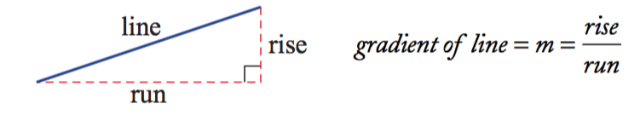
24
7
30
Date
Gradient
EQ – What is Gradient?
What is gradient?
The gradient of a line is a measure of its slope.
It is a number that shows the steepness of a line.
It is calculated by knowing how far a line rises or falls (called the rise) within a certain horizontal distance (called the run).
The gradient is equal to the rise divided by the run.
The letter m is used to represent gradient.

Slide 11
24
7
30
Date
Gradient
EQ – What is Gradient?
What is gradient?
The gradient of a line is a measure of its slope.
It is a number that shows the steepness of a line.
It is calculated by knowing how far a line rises or falls (called the rise) within a certain horizontal distance (called the run).
The gradient is equal to the rise divided by the run.
The letter m is used to represent gradient.
Engineers apply their knowledge of gradients when designing roads, bridges, railway lines and buildings.

Slide 12
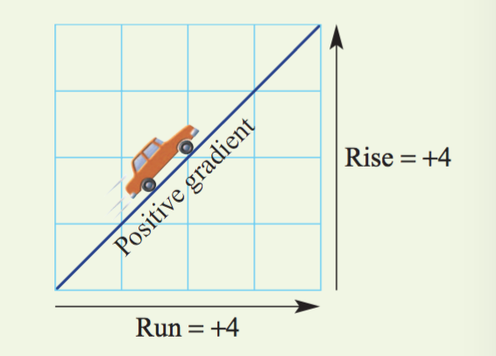
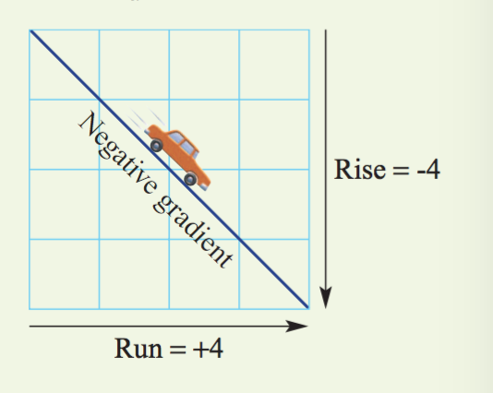
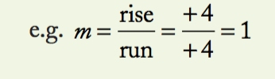
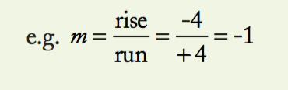
24
7
30
Date
Gradient
EQ – What is Gradient?
Important Note: Always move from left to right when considering the rise and the run.
If the line slopes up from left to right, the rise is positive and the gradient is positive.
If the line slopes down from left to right, the rise is considered to be negative and the gradient is negative.

Slide 13
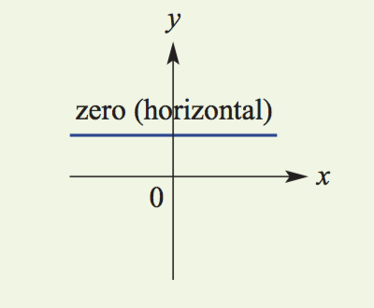
24
7
30
Date
Gradient
EQ – What is Gradient?
The gradient can also be zero (when a line is horizontal) and underfined (when a line is vertical).

Slide 14
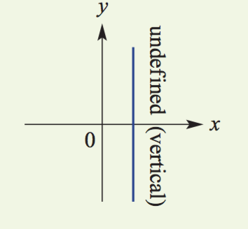
24
7
30
Date
Gradient
EQ – What is Gradient?
The gradient can also be zero (when a line is horizontal) and undefined (when a line is vertical).

Slide 15
Guided practice
Slope Foldable - Work through as a class.

Slide 16
Check for understanding
Completion of gradient foldable
Notes:
Check for understanding

Slide 17
Activity
Gradient revision questions as attached.
Notes:
Independent practice

Slide 18
Closure activity
Exit Pass Attached.
Notes:
Closure

Slide 19
Homework
Review your notes and write a summary answering the essential question.

